Slide 1

Introduction & Passive Components
Intro to DIY Circuit Design
Zhiyang Tsao
Summer 2024

Slide 2

About me
陈 悦开 / Pieski
Electronic Information Engineering,
College of EE, Zhejiang Univ.
Power Electronics
Nothing else, actually
E-mail: tsaozy@zju.edu.cn / tinesharp@outlook.com (after graduation)
Github: https://github.com/Pieski
Wechat: “脑子有坑”in every xlab wechat group

Slide 3




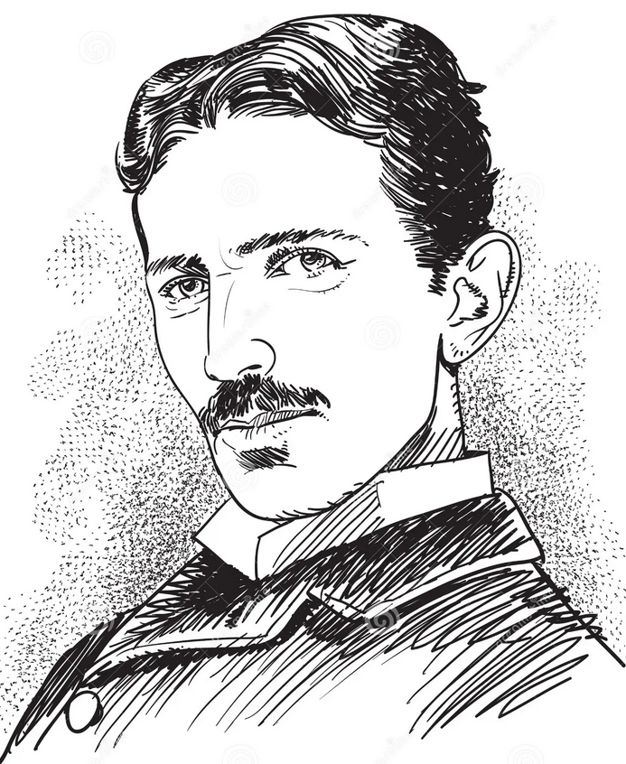
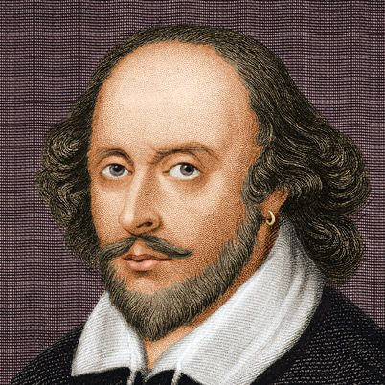

About this program
A brief introduction to the basic electronic engineering
Multiple DIY-level designs
A tutorial of design and simulation tools
A little bit math

Slide 4
On what level do we design?
“Software”
Product
Device on sale
Embedded System
System Level
Module
Too soft
Too big
Too easy
Hardware
Circuit Level
PCBA
Too hard
Too specific
Too hard
Physics, electro-chemistry
IC design
Discrete transistors
Semiconductor
Fricking vacuum tubes

Slide 5
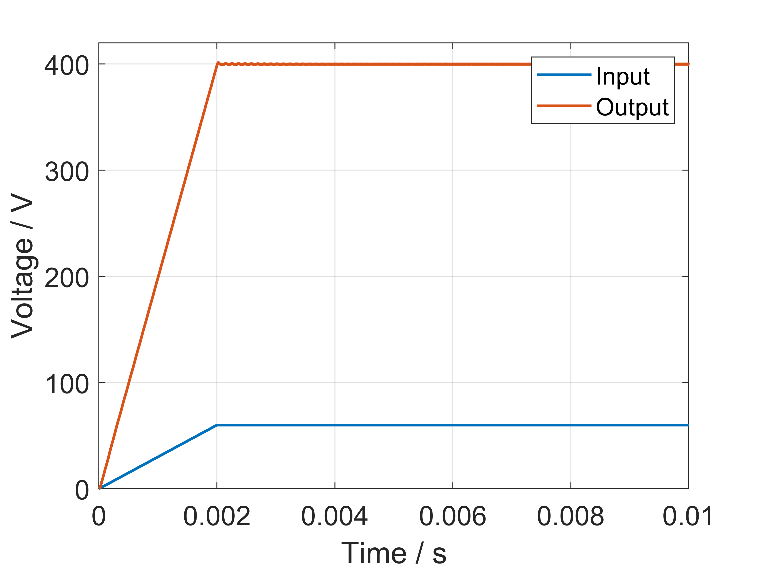
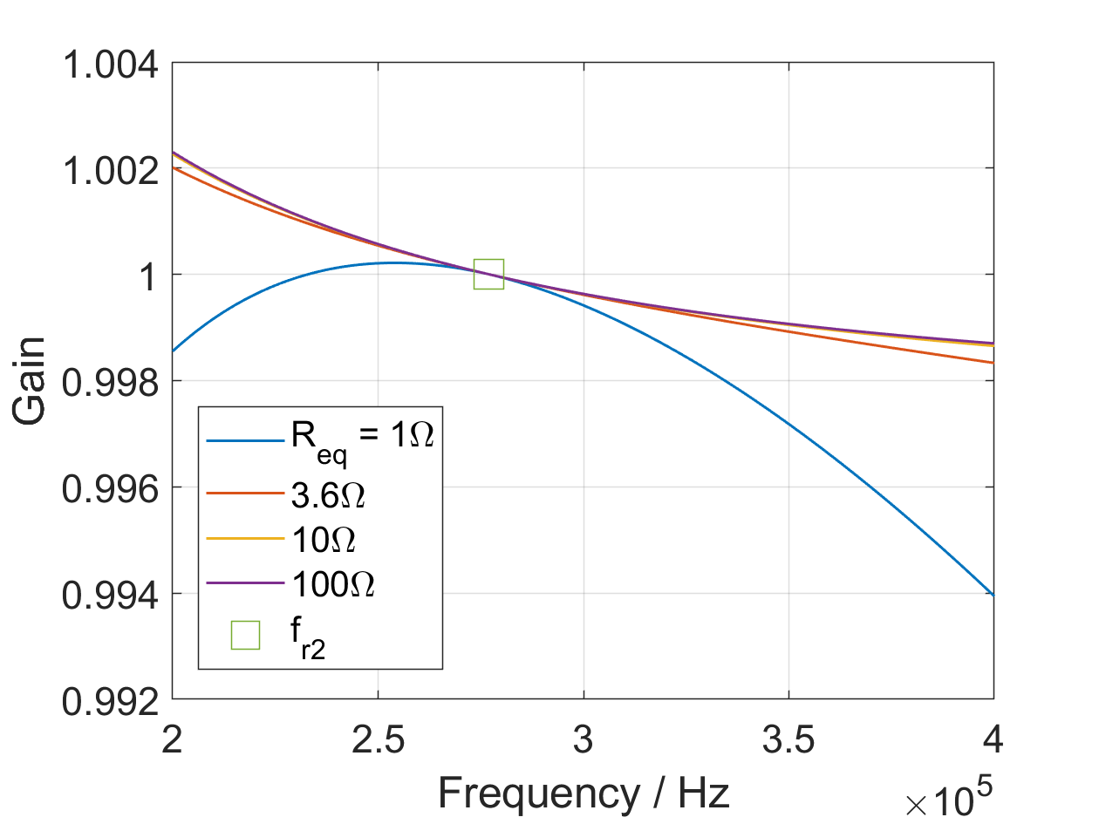
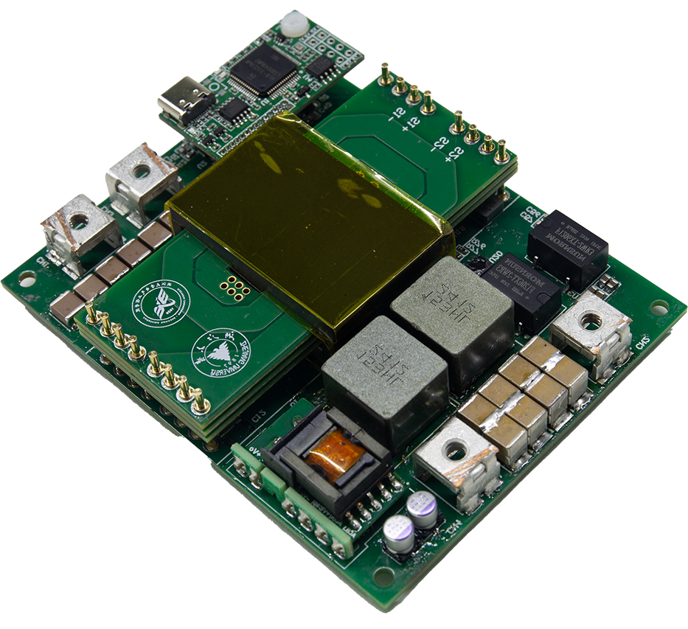
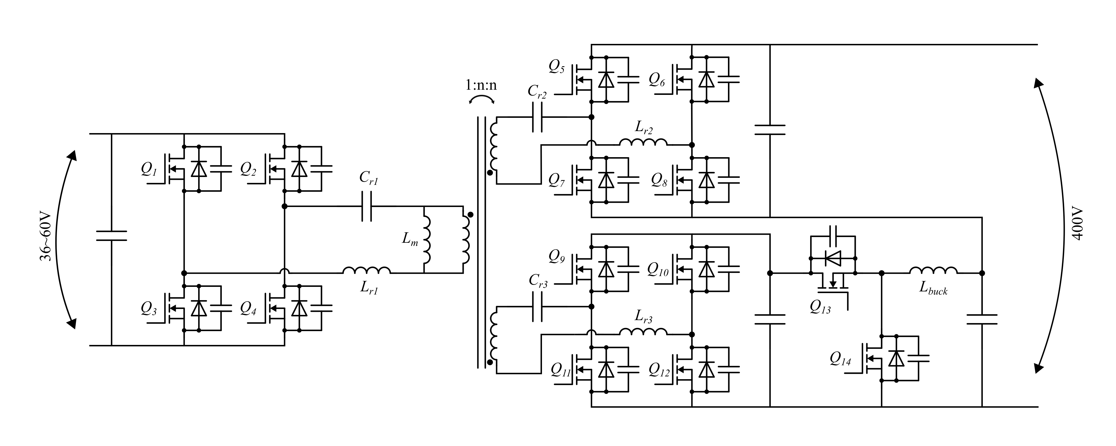
Example: Power Supply
1kW Bidirectional Isolated DC/DC Converter
2024

Slide 6
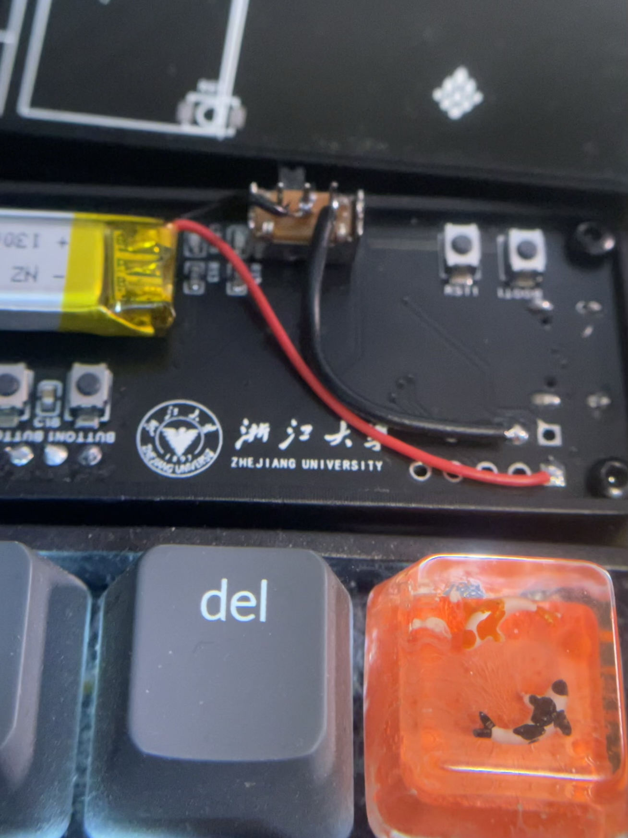
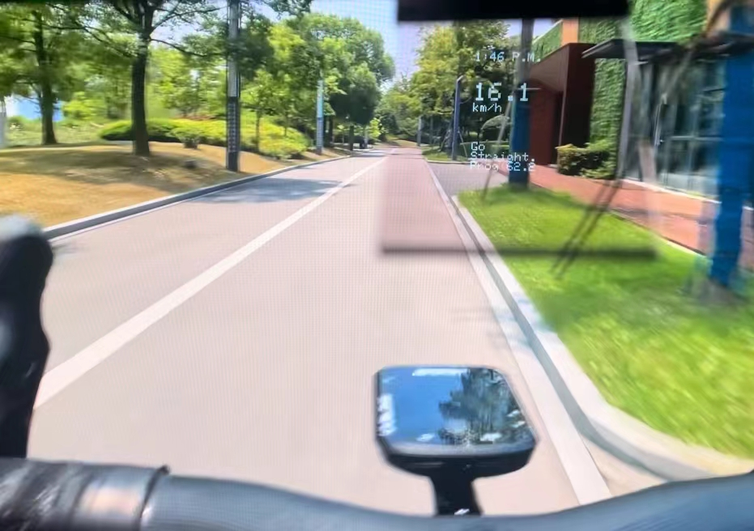
Example: Embedded Hardware
PCBs
AR-Track
2024 bwg
https://github.com/AAAAyl0n/AR-Track

Slide 7
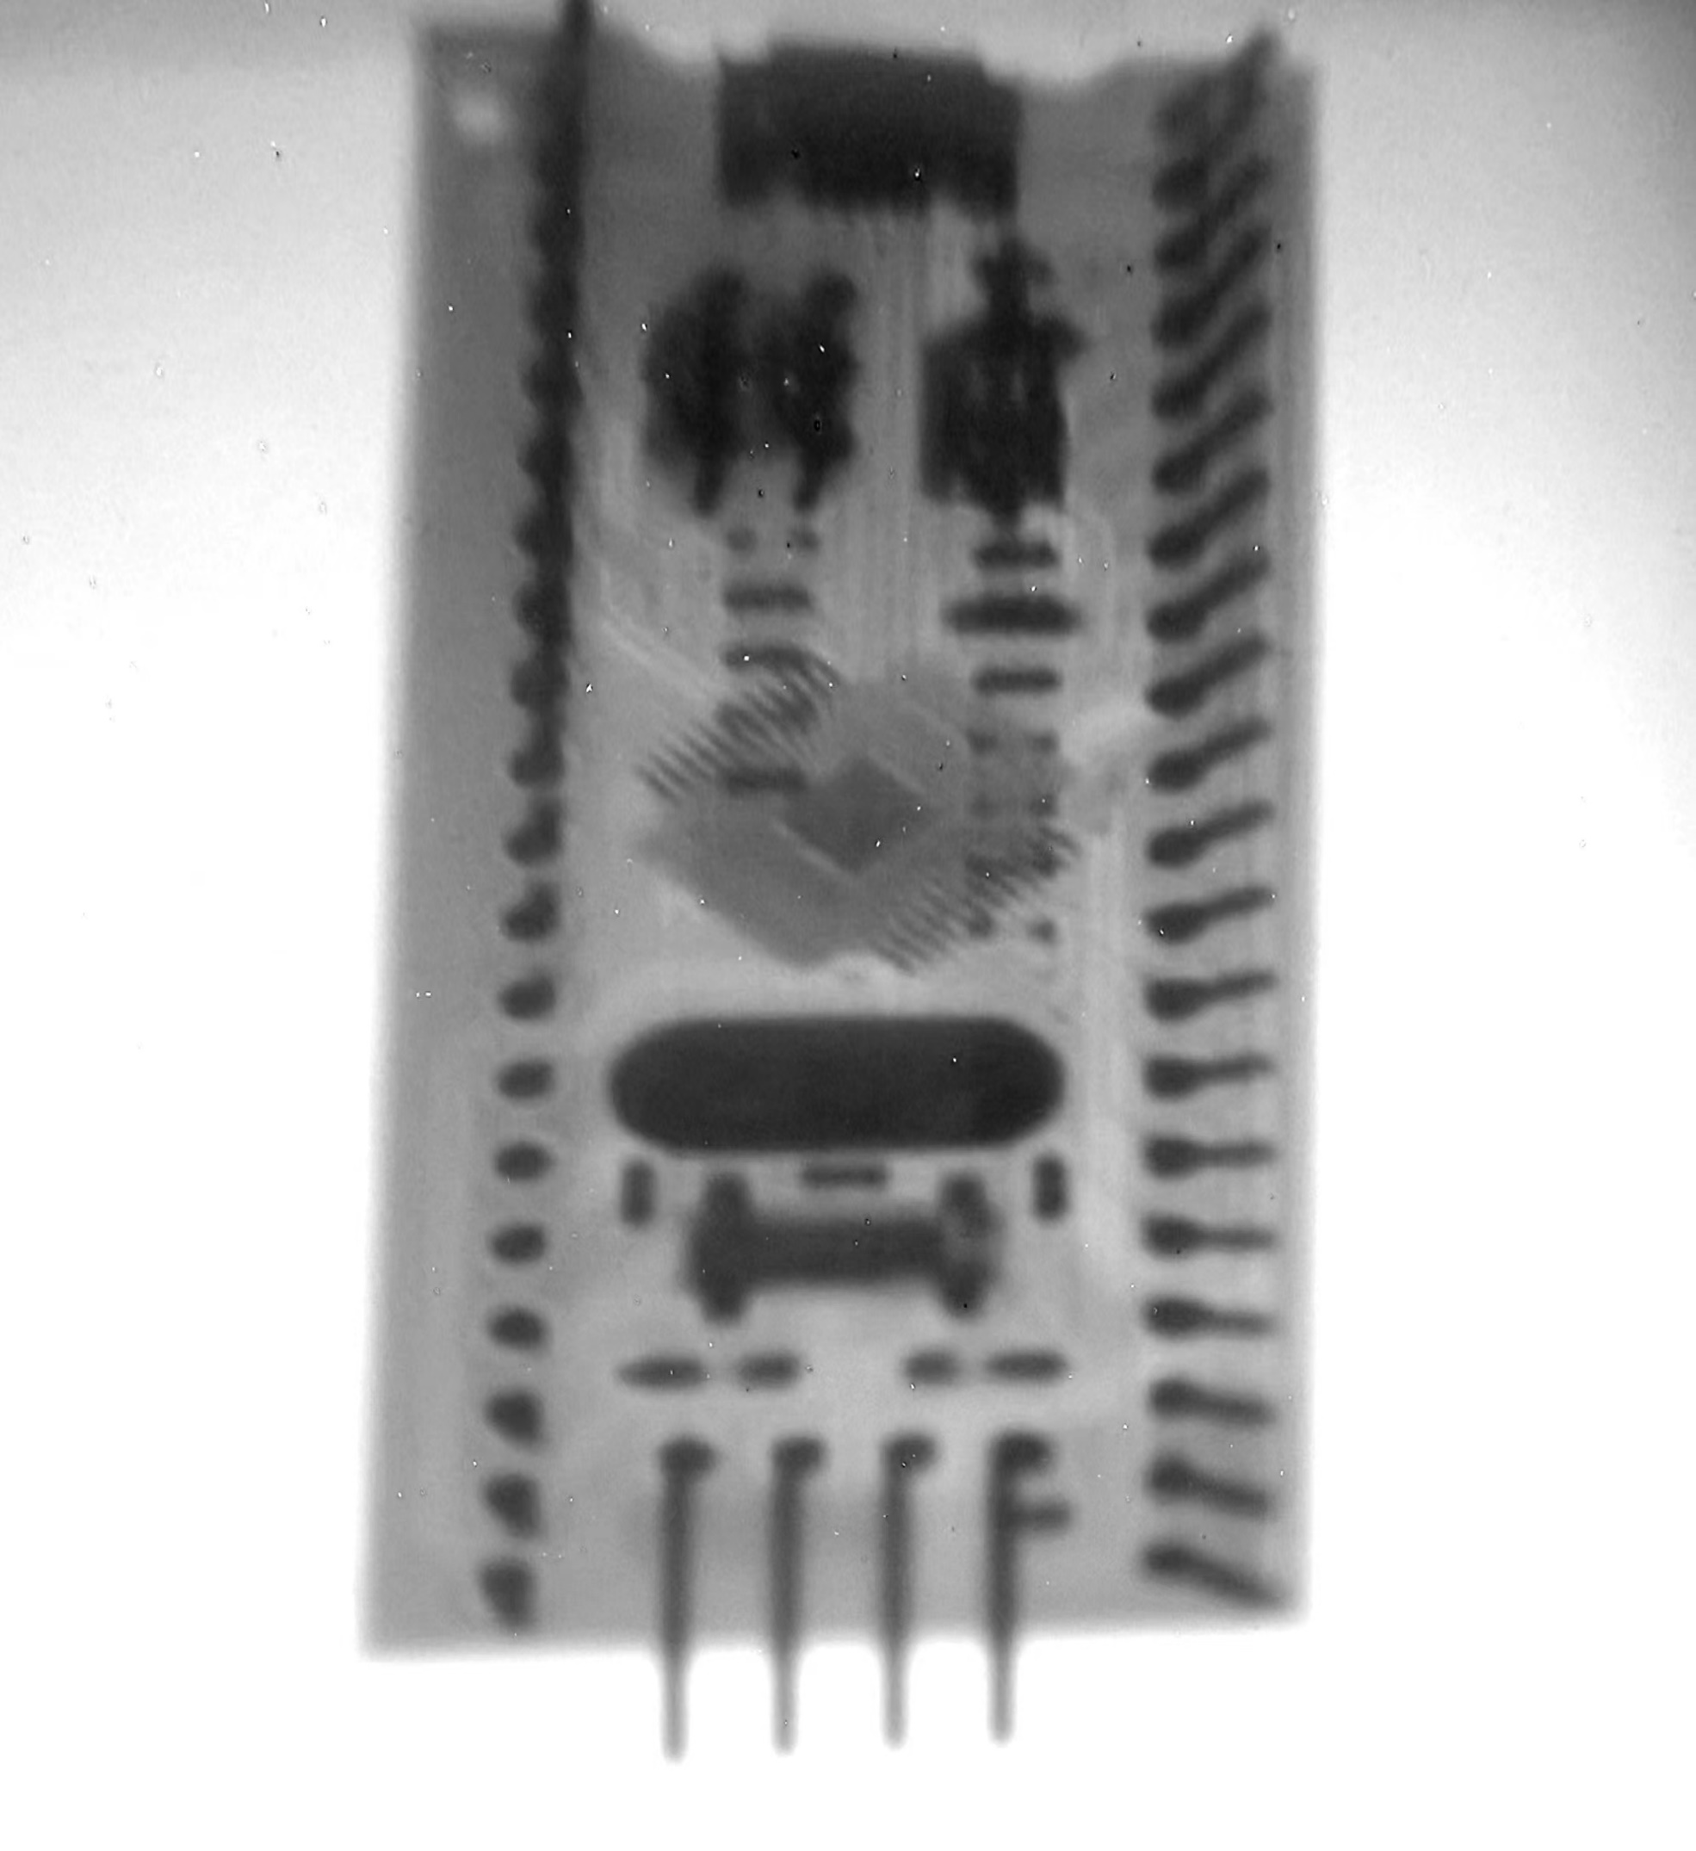
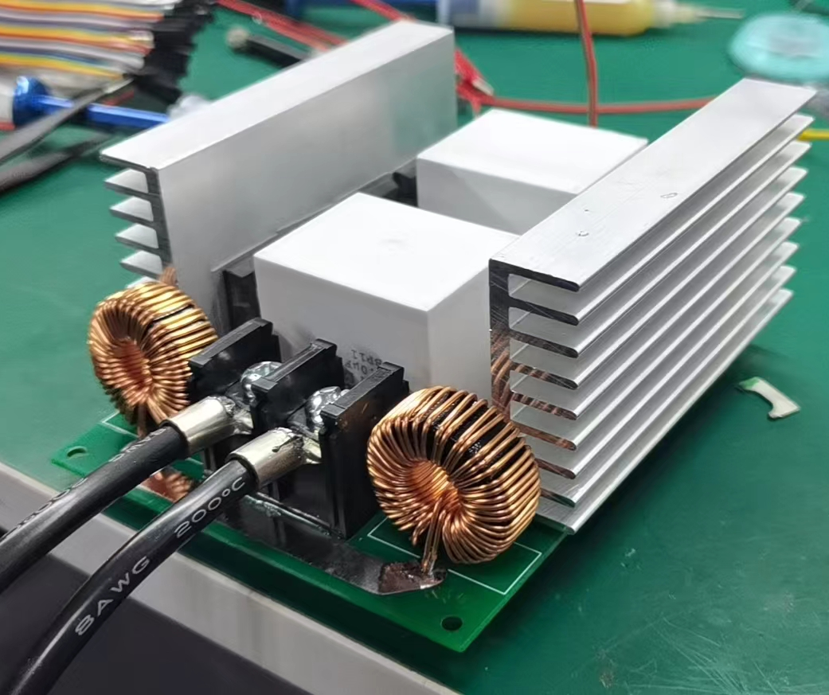
Example: Crazy Ideas
60kV 100W Xray
2022

Slide 8
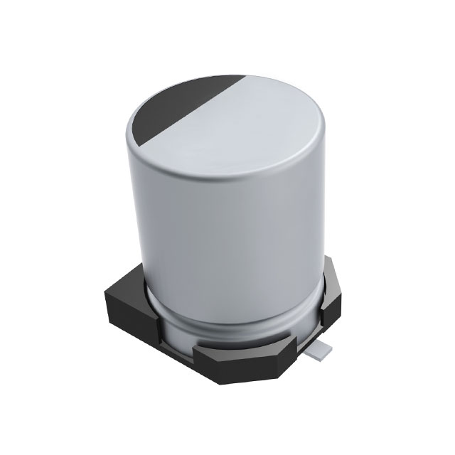
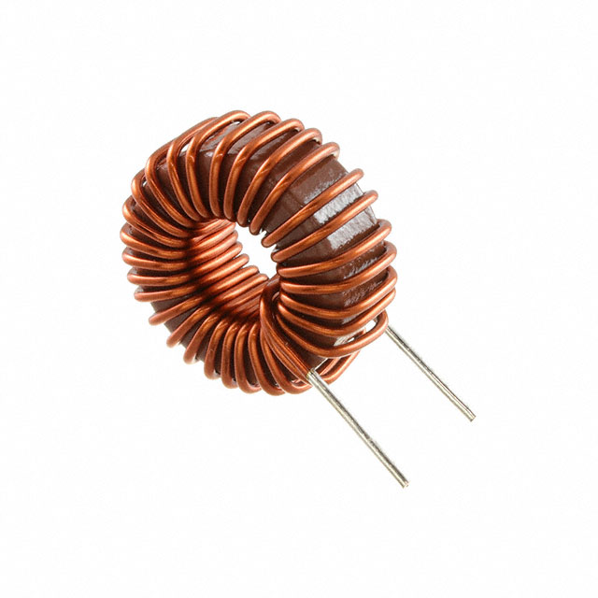
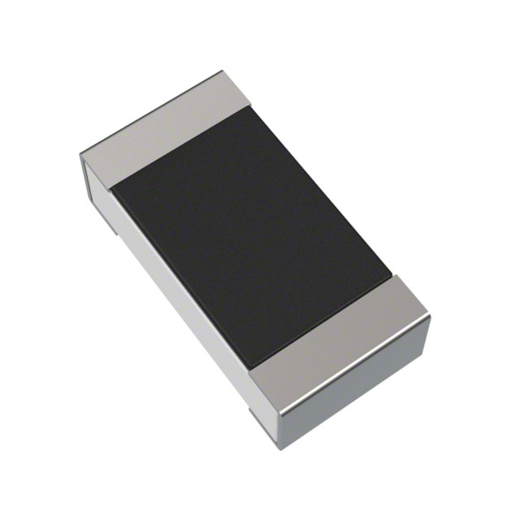
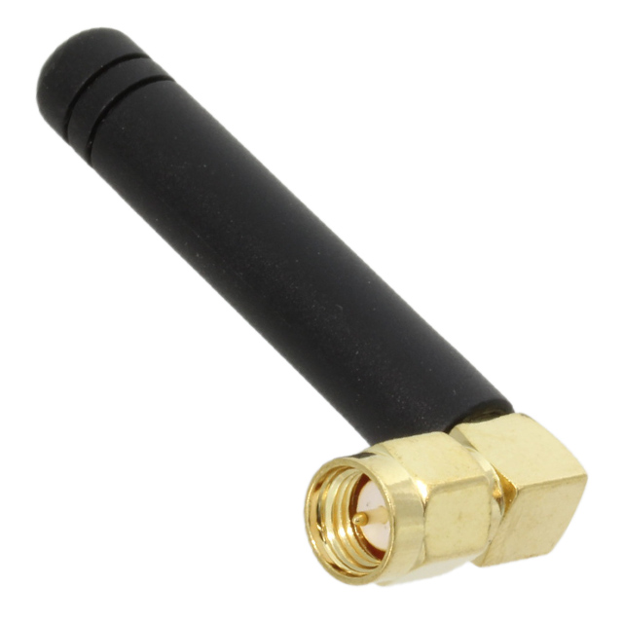
Passive Components
Passive = It only receives energy / it needs no auxiliary supply /
it is incapable of power gain
Resistor
电阻
Capacitor
电容
Inductor
电感
Antenna
天线

Slide 9
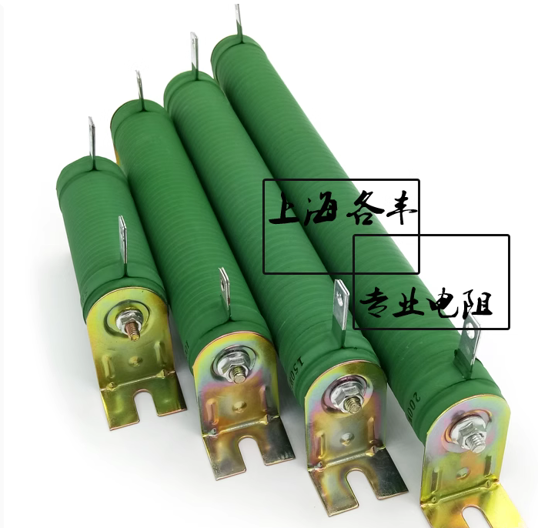
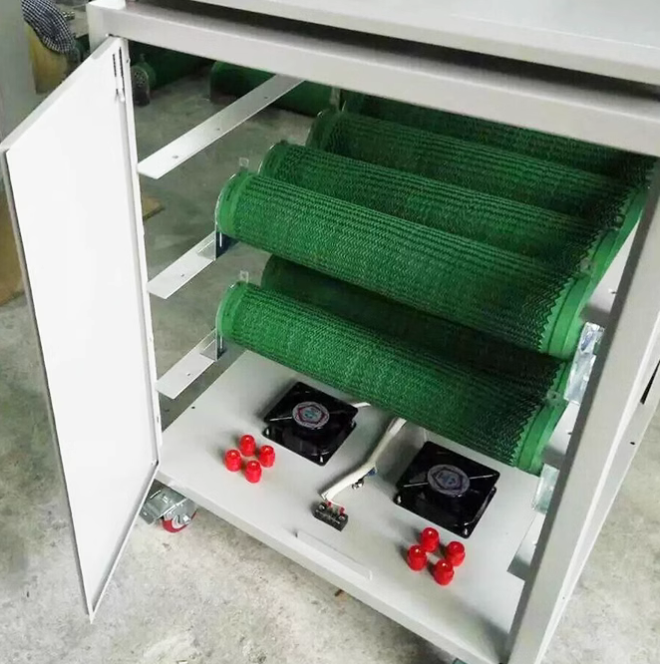
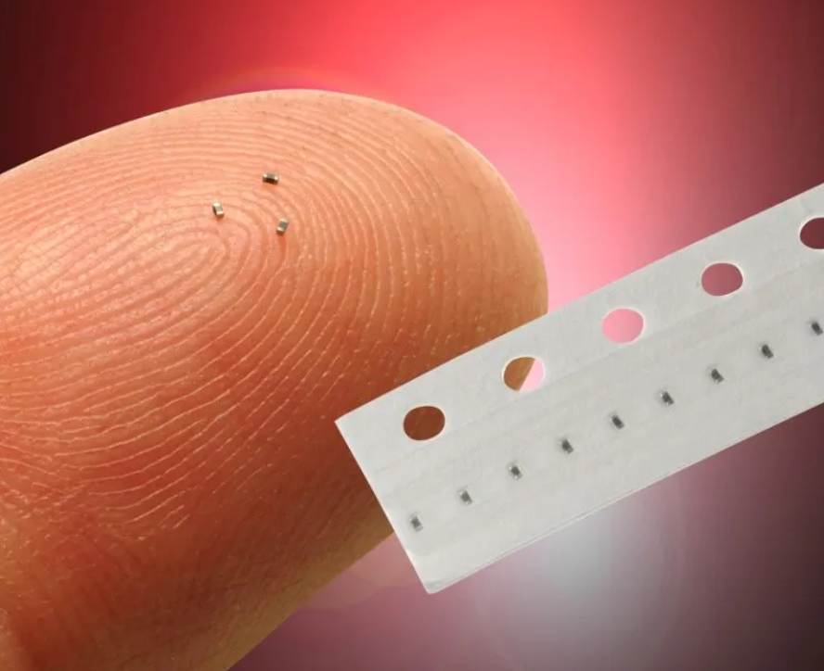
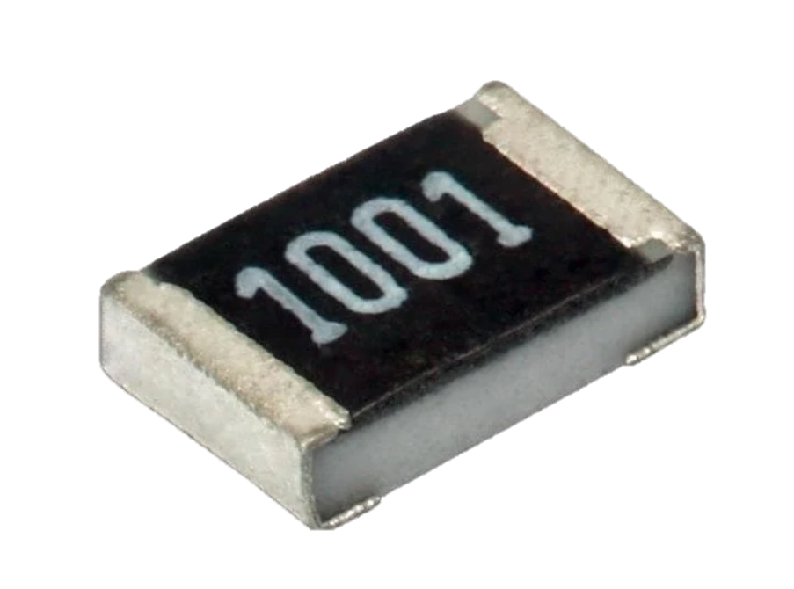
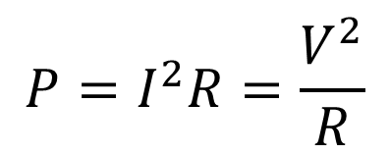
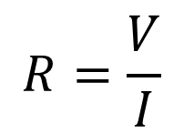
Resistor
$$R=\frac{V}{I}$$
$$P=I^{2}R=\frac{V^{2}}{R}$$
What else?
Always beware of power dissipation!
The higher the loss, the larger the size.
Otherwise raised temeperature would damage the resistor irreversible.
Fan
R0201
P<0.05W
Tubular Ceramic Resistor
瓷管电阻，50W~1kW
Resistive Load Bank
负载箱子, ~100kW

Slide 10
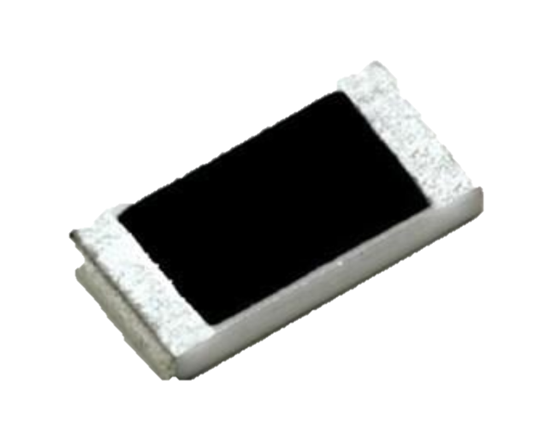
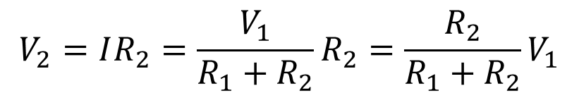
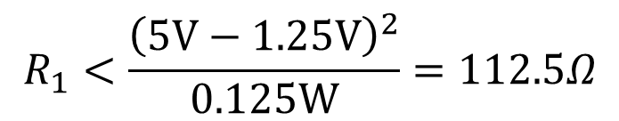
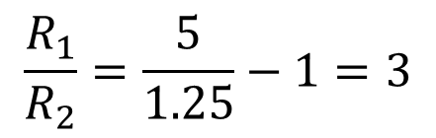
Calculation!
For this moment that menas it needs roughly no current.
Suppose we have a CMOS sensor that requires some 1.25V reference voltage.
But I only got a 5V supply. What to do?
$$V_{2}=IR_{2}=\frac{V_{1}}{R_{1}+R_{2}}R_{2}=\frac{R_{2}}{R_{1}+R_{2}}V_{1}$$
$$\frac{R_{1}}{R_{2}}=\frac{5}{1.25}−1=3$$
It only tells us the ratio!
At XLAB we prefer 0805 resistor
For R0805, P<1/8W
$$R_{1}<\frac{{\left(5V−1.25V\right)}^{2}}{0.125W}=112.5Ω$$
A basic resistive voltage divider

Slide 11
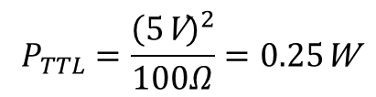
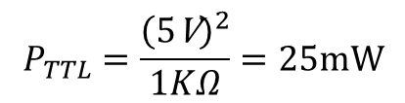
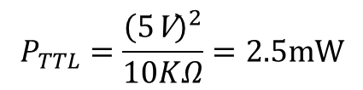
Easier approach
At XLAB we prefer 0805 resistor
For R0805, P<1/8W
永铭 prefers 0603 resistor
P<1/10W
In future you might need R0201
P<1/20W
Approach for the lazy is to start with 10KΩ. It works for most scenarios.
$$P_{TTL}=\frac{{\left(5\text{V}\right)}^{2}}{10KΩ}=2.5mW$$
$$P_{TTL}=\frac{{\left(5\text{V}\right)}^{2}}{1KΩ}=25mW$$
$$P_{TTL}=\frac{{\left(5\text{V}\right)}^{2}}{100Ω}=0.25\text{W}$$
Harmless
Worth attention
Unaccepctable
Beware that 2.5mW is still too high
for certain μW-level ultra low power
applications.
Sometimes you have to compromise
between loss and speed

Slide 12
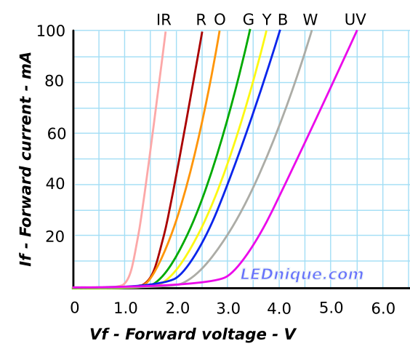
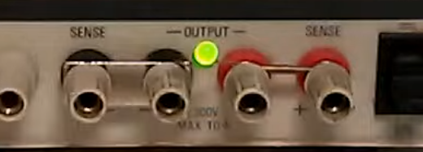
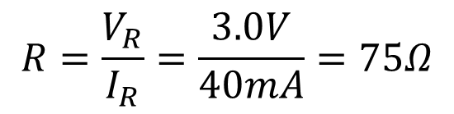
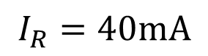
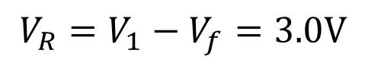
More calculation
Suppose we want a red LED works on
Vf = 2.0V & If = 40mA
$$V_{R}=V_{1}−V_{f}=3.0V$$
$$I_{R}=40mA$$
$$R=\frac{V_{R}}{I_{R}}=\frac{3.0V}{40mA}=75Ω$$
This chart is plotted for large LEDs!

Slide 13
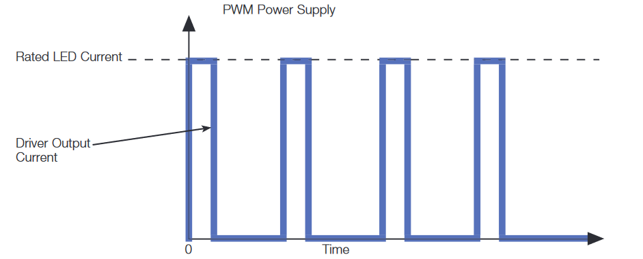
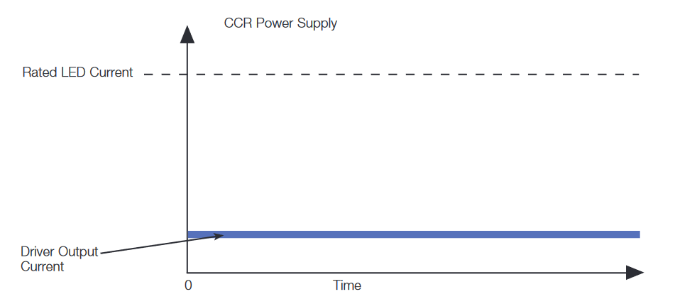
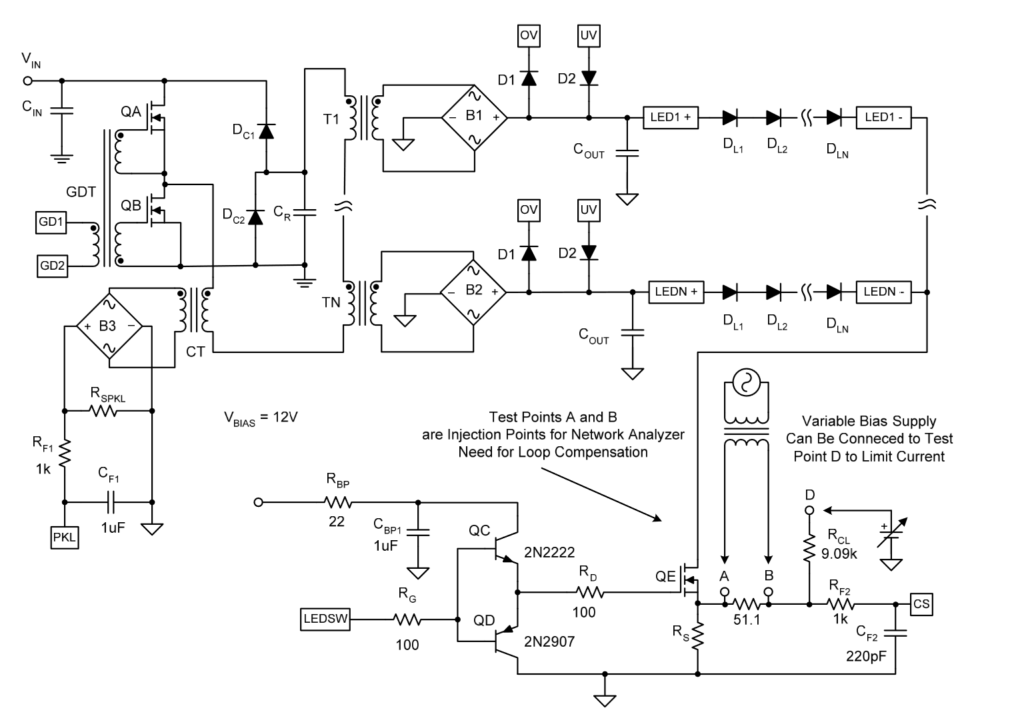
How do we actually drives (a lot of) LEDs?
1. PWM
2. CCR
With PWM techniques, luminous flux of LED can be reduced to less than 40% while remaining consistent color.
It a little bit complex, though.
NOTE: LED dimming is a suggested DIY project for this summer

Slide 14
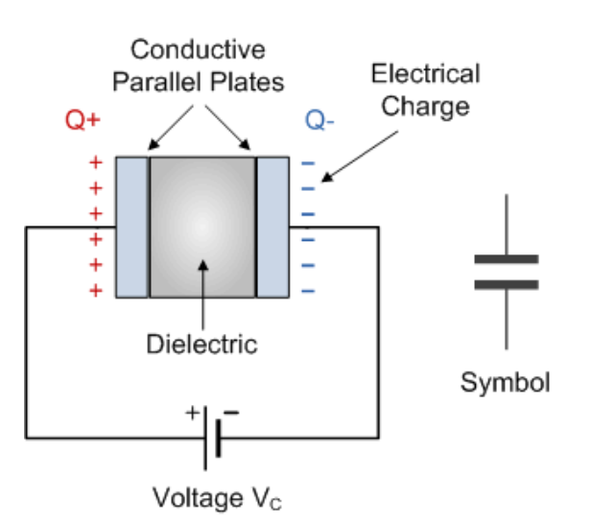
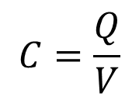
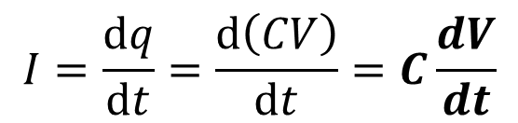
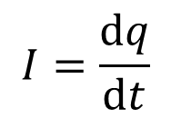
Capacitor 电容
$$C=\frac{Q}{V}$$
Charge quality 电荷量
It is defined as:
Voltage
For any component we are interested in its I-V characteristic
But we only got voltage here.
Recap: how is current defined?
$$I=\frac{dq}{dt}$$
Charge flows through some area within
an element of time
$$I=\frac{dq}{dt}=\frac{d\left(CV\right)}{dt}=C\frac{dV}{dt}$$
Assume that C is time-constant
Current flows through a capacitor is proportional to
The derivative of voltage over time / the voltage changing rate

Slide 15
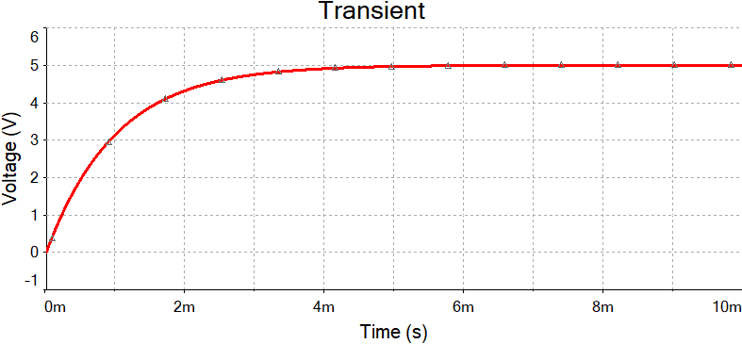
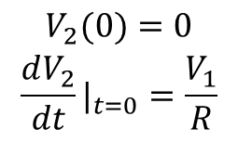
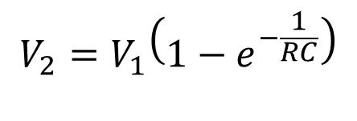
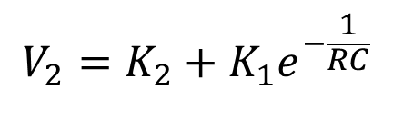
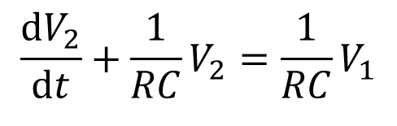
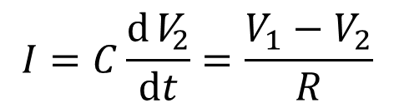
Plug a capacitor in DC supply
$$I=C\frac{{d\text{V}}_{2}}{dt}=\frac{V_{1}−V_{2}}{R}$$
$$\begin{matrix}\frac{dV_{2}}{dt}+\frac{1}{RC}V_{2}=\frac{1}{RC}V_{1} \\ \end{matrix}$$
$$\begin{matrix}V_{2}=K_{2}+K_{1}e^{−\frac{1}{RC}} \\ \end{matrix}$$
$$\begin{matrix}V_{2}(0)=0 \\ {\frac{dV_{2}}{dt}|}_{t=0}=\frac{V_{1}}{R} \\ \end{matrix}$$
$$\begin{matrix}V_{2}=V_{1}\left(1−e^{−\frac{1}{RC}}\right) \\ \end{matrix}$$
Boundary conditions, BCs

Slide 16
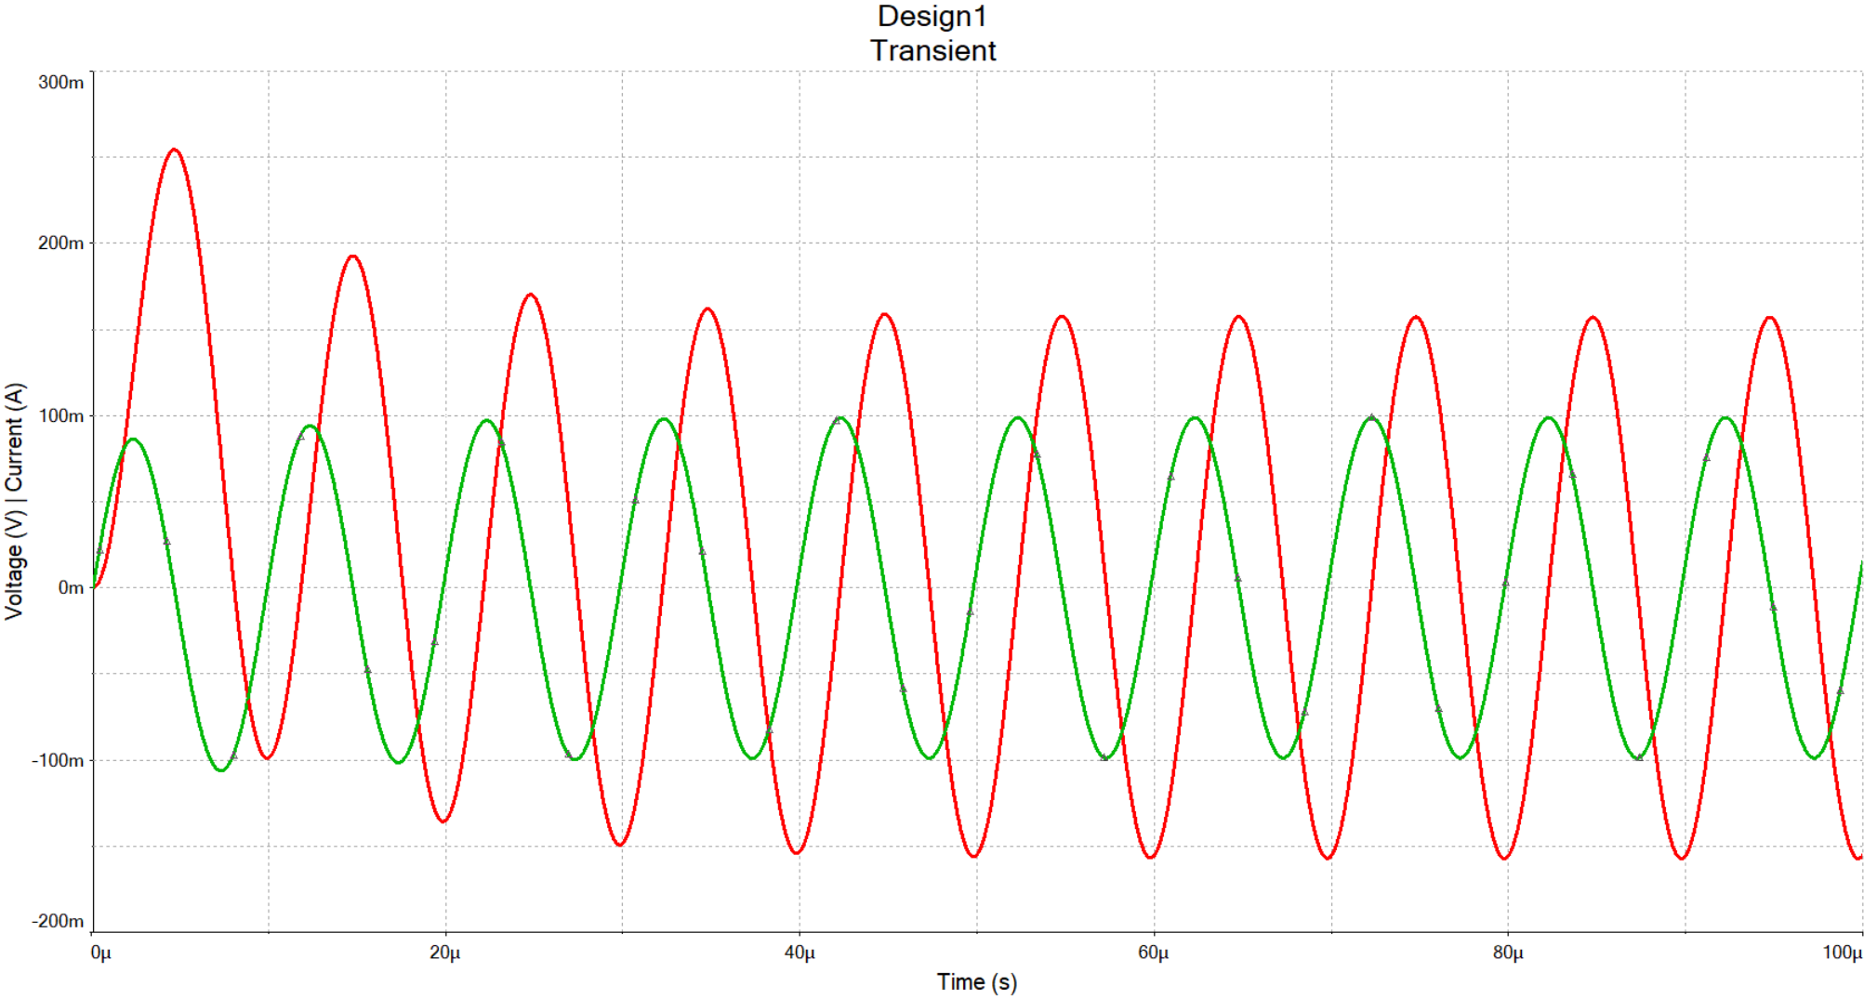
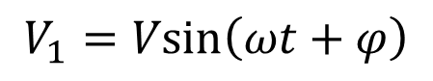
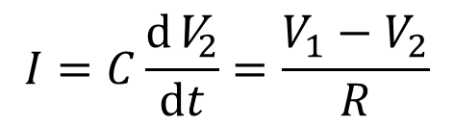
Plug a capacitor in AC supply
$$I=C\frac{{d\text{V}}_{2}}{dt}=\frac{V_{1}−V_{2}}{R}$$
Still stands, But V1 is now
$$V_{1}=Vsin\left(ωt+φ\right)$$
Transient State
Steady State
You may solve the ODE function, but it is really desperating when the circuit got complicated
In most cases we only care about the steady state, and there are easy tools to solve it.

Slide 17
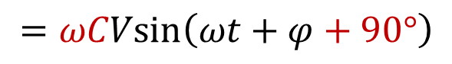
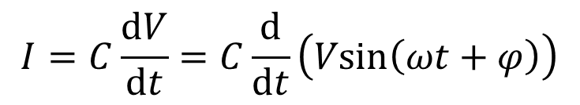

Conclude the capacitor in a nut shell
隔直通交
$$I=C\frac{dV}{dt}=C\frac{d}{dt}\left(Vsin\left(ωt+φ\right)\right)$$
Forget about R1,
$$=ωCVsin\left(ωt+φ+90°\right)$$
We may define a property Reactance in letter X, just like the resistance
$$X_{C}=\frac{|V_{C}|}{|I_{C}|}=\frac{1}{ωC}$$
The higher the frequency, the lower the reactance of a capacitor.
You may consider it as a frequency-dependent resistor.
When f=0 (DC condition) and in steady state, Xc->∞. In other words it blocks DC current.
When f->∞ (high freq condition) and in ss, Xc->0. It conducts AC current.

Slide 18



One application: Filter
Recoder
A 20kHz noise
A composition of sine wave
of 1k, 5k and 7kHz

Slide 19

0.1uF + 10uF
Where is the resistor in the RC filter?
Filter capacitors

